Slide 1

Grocery Store Management System
Object Oriented Programming in Java

Slide 2

Group members:
Vo Pham Khang Huy – 10421082
Ly Minh Hung – 10421079
Pham Phu Tuan Khoa – 10421129
Nguyen Tien Khoa – 10421085

Slide 3




Contents
Classes
Conclusion
Databases
Demo

Slide 4
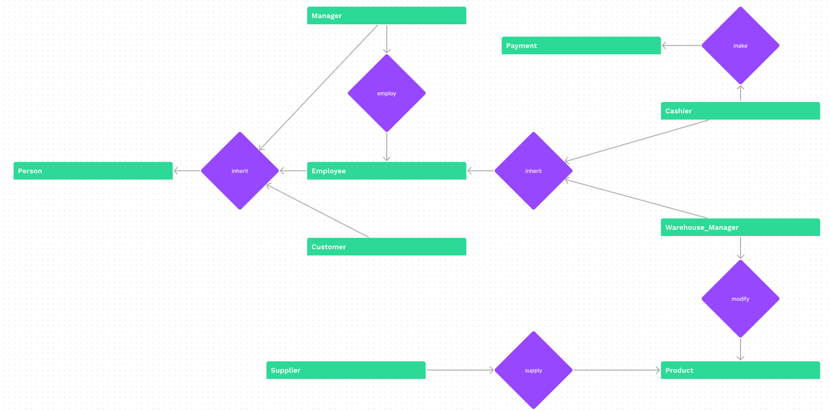
Class Diagram

Slide 5
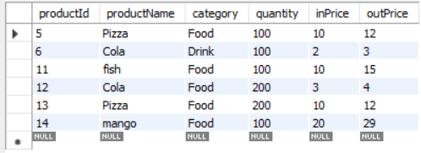
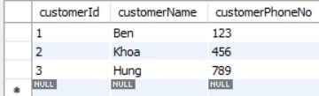
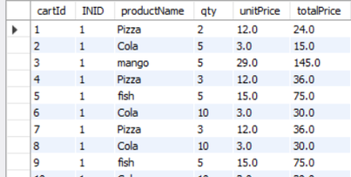
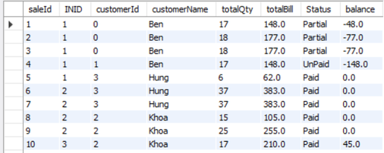
Some Database Tables
Product
Customer
Cart
Sales

Slide 6
Conclusion

Slide 7

Demo

Slide 8

Thank You!

